Slide 1
Stakeholder meeting on the SHIFT²RAIL Strategic Master Plan
Manuel Pereira, IST Lisbon
ERRAC Vice Chairman
20th June 2014, Brussels

Slide 2
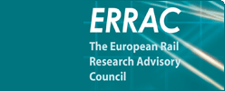
What is ERRAC?
ERRAC is the European Technology Platform for rail*.
ERRAC aims at revitalising the European rail sector and make it more competitive, by fostering increased innovation and guiding research efforts at European level.
Representatives from all the major European rail research stakeholders are gathered:
Railway operators;
Infrastructure managers;
Manufacturers;
The European Commission;
EU Member States;
Academics;
Users’ groups.
ERRAC covers all forms of rail transport: from conventional, high speed and freight applications to urban and regional services.
* Founded in 2001

Slide 3
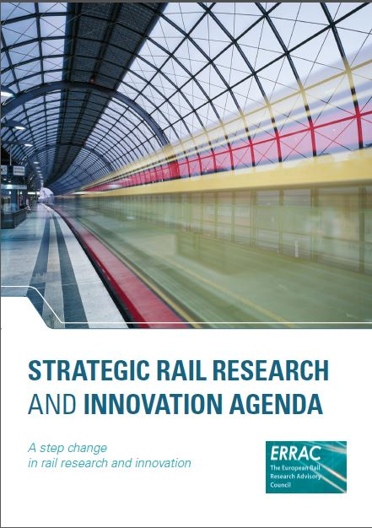
Strategic Rail Research and Innovation Agenda – SRRIA
May, 2014
Vision and targets (2050)
the rail share of both the freight and passenger markets will double
the rail freight and passenger market volumes will more than triple as compared with 2000
Guiding rail research and innovation efforts for Horizon 2020 and beyond

Slide 4
Challenges
The “Customers” concept
The customer experience becomes one of the major strategic outcomes.
“C U S T O M E R S” is a concept encompassing all the major challenges the railway sector is facing:
C - Capacity
U - User
S - Safe and Secure
T - Technological breakthrough & competitiveness of the sector
O - Optimised design and interoperability
M - Maximised value for money leading to modal shift
E - Efficient & environmentally sustainable
R - Reliable & resilient
S - Skills

Slide 5
SRRIA – Thematic priorities
CONTROL, COMMAND
AND SIGNALLING
System approach
Capacity, performance and competitiveness
Energy and environment
Safety and security
ASSETS
ROLLING STOCK
INFRASTRUCTURE
IT & OTHER ENABLING
TECHNOLOGIES
TRAINING AND
EDUCATION
ATTRACTIVENESS OF RAIL AND PUBLIC TRANSPORT

Slide 6
ERRAC & SHIFT²RAIL
“ 'S2R Master Plan' refers to a common, forward-looking strategic roadmap, to be developed by the S2R Joint Undertaking, in consultation with the European Railway Agency and the European Rail Research Advisory Council (ERRAC) Technology Platform, to drive innovation in the rail sector on the long term”.*
* From the annexes of the Council Regulation establishing the Shift2Rail Joint Undertaking

Slide 7
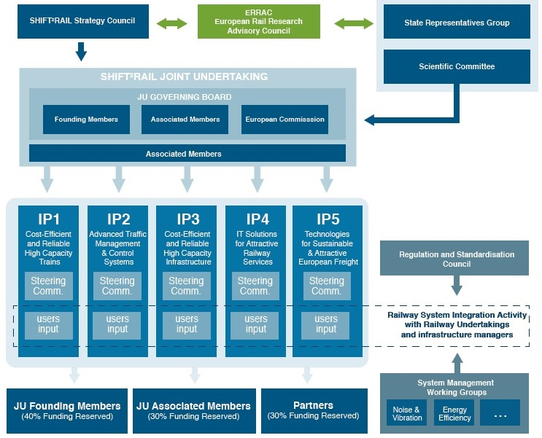
ERRAC & SHIFT²RAIL

Slide 8
ERRAC SRRIA
Supporting the SHIFT²RAIL concept
The SHIFT²RAIL objectives are in line with
the ERRAC SRRIA priorities
SHIFT²RAIL to pursue focused, market-driven research and innovation (R&I) accelerating the integration of new and advanced technologies into innovative rail product solutions.
SHIFT²RAIL will promote the competitiveness of the European rail industry and will address changing EU transport needs.
The establishment of “Requirements and Implementation groups” involving the rail stakeholders will ensure a system approach to the specification of the needs
Involvement of forward-looking market actors ready to invest in innovation and a commitment to inclusiveness ensuring a wide participation of all actors at European level.

Slide 9
ERRAC & SHIFT²RAIL
ERRAC Feedback
Standardisation and standard architectures are key issues;
Application to railway systems: address the specificities of urban rail
Enhancement of knowledge transfer amongst European Railways; Implementation of these findings though the appropriate funding scheme.
Use of Key Performance Indicators (KPIs) to measure both the progress amongst different rail segments as well as with the other transport modes.

Slide 10
ERRAC leadership:
Commitment to innovation
Well-defined societal, cost and technology drivers:
global, systemic and unified perspective
business opportunities,
customer needs and user rights,
technology drivers, new materials
environmental issues
a base of technology resources and capacity for innovation
Progressing towards higher TR Levels:
The Innovation chain from blue sky research, applied engineering up to demonstration and market uptake (roll-out / deployment) shall be addressed at European level in coordination with the European Commission and Member States;
Overcome major barriers in the regulatory and legal domain
Supporting research market uptake

Slide 11
ERRAC & SHIFT²RAIL
Conclusion
ERRAC welcomes the adoption of the SHIFT²RAIL Council Regulation on 16 June 2014.
The SHIFT²RAIL objectives and priorities are in line with the SRRIA priorities
ERRAC has highlighted a number of points to be taken into consideration in the drafting of the strategic Master Plan and is committed to the implementation of SHIFT²RAIL
Due to budgetary constraints, SHIFT²RAIL cannot cover all of the ERRAC priorities from the SRRIA.
ERRAC is committed to work with the European Commission to find other financing opportunities for other rail-related topics in Horizon 2020

Slide 12
Thank you for your attention www.errac.org

